Slide 1
Progression System
There are 3 main ways we can implement progress into our game
 | Stage Based | Stage + Waves | Endless (Waves)
Overview | Pre set enemy locations, levels are beaten by defeating all enemies | Stages are used but multiple waves of enemies need to be defeated | Enemies are spawned somewhat randomly on a single stage, there is no defined win condition
Pros | Easiest to program Allows a large variety of different stage designs Stages are fast to create Players will have a constant sense of progress | Most balanced progress system Less stages need to be created as each stage is longer Less navigating menus than standard stage based (more focus on gameplay) | Largest gameplay variety (replay value) Easiest to create asset wise
Cons | Stages may be too short Large number of stage assets needed (thus large file size) | Harder to program Players may feel cheated if they lose a stage in a later wave | Players wont feel like their progressing without adding new mechanics like a shop Heavy reliance on randomness (Game could be too easy or hard)

Slide 2
Difficulty Increment mechanics
Our game inherently has a problematic negative feedback loop being that the less enemies there are the easier the game gets (so the better you play the easier it gets)
Increasing the games difficulty can be done in a few ways:
Raising enemy count (And spacing out enemies more)
New enemy types with new strategies
Adding stage hazards
Increasing enemy stats (Health points for enemies?)
Giving the enemies more complex AI (e.g. they attempt to evade bullets if they can) ~ probably unfair to play against
Making the stage more disadvantageous to the player
Disadvantaging the player (Taking away abilities or enlarging their hitbox?)

Slide 3

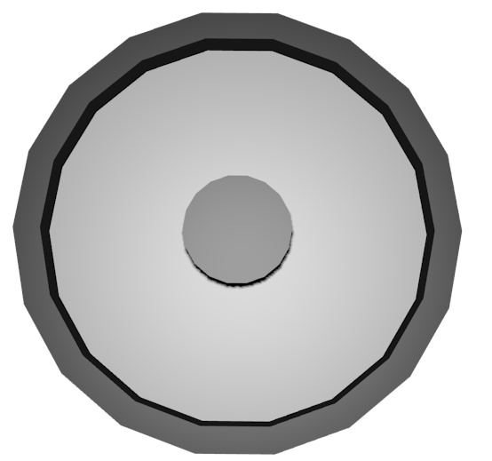
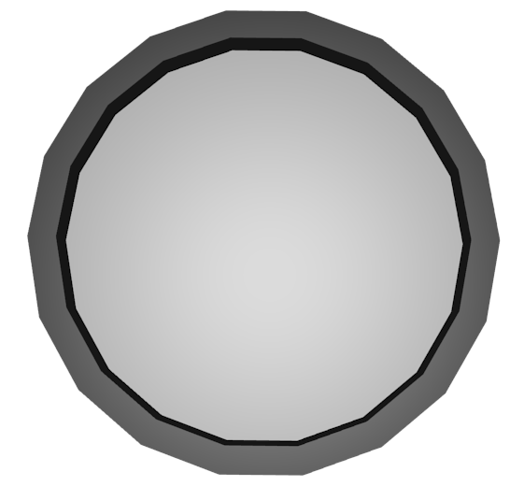

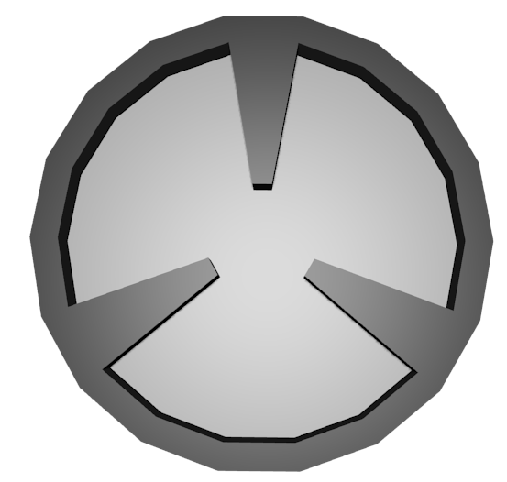

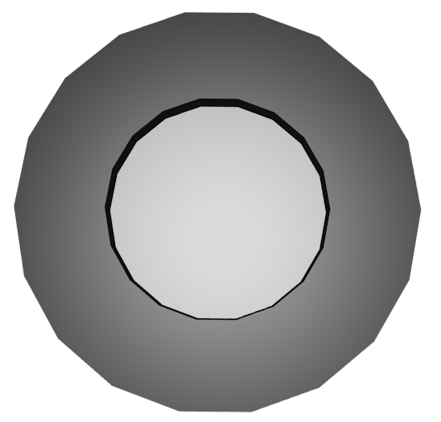
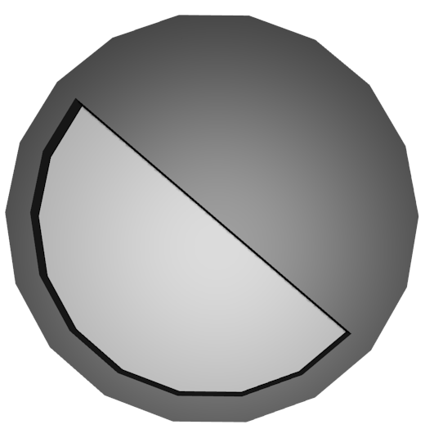
Stage Designs
Placing a single block in the centre of a stage gives the player sufficient cover from long distance attacks while forcing them to get closer to enemies, it can also break up the fighting a bit
Similar to the last concept but adding a barrier to the stage makes it far more linier, this is unlikely to work in wave based games but would allow the player to take on enemies in a linier order in stage based games
The most basic stage that we could create would be a empty circle, this however would allow for the most undisrupted gameplay
A stage with small amounts of cover would be the easiest idea to create however in our game it might be frustrating to make enemies line up shots correctly
We could also create stages with hazards such as indestructible turrets, pitfalls or moving barriers although these may be unnecessarily complex and may make the game too difficult.
Diving the stage into multiple sections restricts the play area, this would work well if we wanted to player to fight multiple small groups of enemies at once
This is an alternate version of the barrier stage however redesigned so that you can travel either way, although its function is the same (face enemies in a “near” linier order)
Both of these designs are designed to reduce the play area, the left design if easier to work with but forces you to be at constant close range of enemy characters whereas the right is the opposite (long range, harder to strategize around)

Slide 4
Enemy Mechanics
The base flow chart of an enemy should be:
If Enemy is too close move away from player, If enemy is too far move towards player
Move somewhat randomly within the “safe” distance from the player
Stop moving and have an effect which represents that they are about to fire
Shoot towards the player
Stand still for a predetermined amount of time
Repeat until defeated or last enemy standing
Things to note when following this:
Different enemy types (if we decide to uses them) will have different stats (e.g. firing delay, safe distance, health)
Enemies must be somewhat synchronised, (either force enemies to all fire on a set interval or have progressively shortening intervals so firing will be constant at some point) This is essential as two un-synchronised enemies may never shoot one another if one moves out of the way while the other shoots
One way we could alleviate this and the negative feedback loop would be to reduce the fire intervals as more enemies are eliminated resulting in a higher chance of two enemies hitting one another but also noticeably increasing the number of projectiles that need to be avoided

Slide 5
Enemy type concepts
In planning we discussed alternate enemy types which need to be combatted in slightly different ways. If we decide to use them I have come up with a number of possible concepts for them
Enemy Type | Overview
Standard | Follows the mechanic discussed prior
Close Range | Safe firing radius is closer to the player, more agile with longer post firing delays but shorter pre firing delays In short a more hostile enemy
Sniper/Long range | Safe firing radius is further from the player, slower with faster traveling projectiles and a longer pre firing delay to give the player a degree of warning
Shielded | In short a enemy with a shield blocking where they fire, could function like extra health for the enemy or could force the player to get them shot from behind (this would require a significantly slower turn rate and speed though)
Magic | Shoots ricocheting projectiles. Unlikely to function well in the game, higher chance on hitting other enemies and only a slightly higher chance of hitting the player but might provide an interesting dynamic if it were used. Could instead use somewhat homing projectiles that only home in on the player for a few seconds then travel in a straight line but this may be too hard to program
Anti-FF Enemies | Fire multiple bullets before moving that decay faster than usual, this would make them more vulnerable but also less likely to hit other enemies due to the decay effect.
Tracers (High difficulty) | Fire bullets that leave paths deadly to the player behind in their path, bullets will also travel significantly slower because of this.

